Slide 1
Google Shopping
With special focus on INT MPs

Slide 2
CONTENT
What is GS about?
Ranking Factors
Current Tests and Results
Conclusion and Perspectives

Slide 3
GOOGLE SHOPPING VISIBILITY

Slide 4
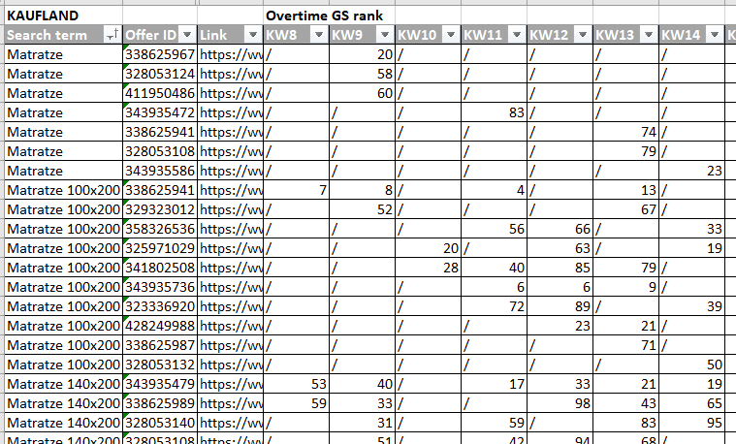
Reporting Google Shopping
Report for all the marketplaces including the offers ranked on google shopping for matresses and toppers
Crawling on Wednesday afternoon
Relevant keywords based on search volume
Monitor changes in the ranking that could explain increase/decrease in the sales

Slide 5
What is GS and how does it work?
Service provided by Google → search, view, compare products
Products are dispalyed when searching for a product/ product related keywords in the main SERPs or/and under the shopping tab
All MPs (we are selling on) are listing offers on GS
Offers are submitted via product data feed → In Campaigns it is not keywords that determine relevancy (no bid on keywords), but all data in the feed → match of search query with title/content

Slide 6
Ranking Factors
In our control
Titles and descriptions
Pictures without icons
Submitting complete and accurate product data to MPs
MPs control
Bid, daily budget, campaign settings
Submission frequency
Submitting accurate and complete data
Other
Competion from other merchants
Google`s ranking algorithm (constantly changing)
How much Google promotes product search / Customer demand
Customer demand for specific products

Slide 7
Perspectives
General goal: Creating conditions based on learnings to ensure a high potential to be listed across all MPs → defining measures
Focus on MPs that are responsive to optimizations, e.g. Darty with goal to improve performance in terms of sales
Changing all pictures, optimizing content, pricing
Further testings on MPs with better performing offers as test cases (Confo) for INT MPs

Slide 8
GOOGLE SHOPPING TEST CASES

Slide 9
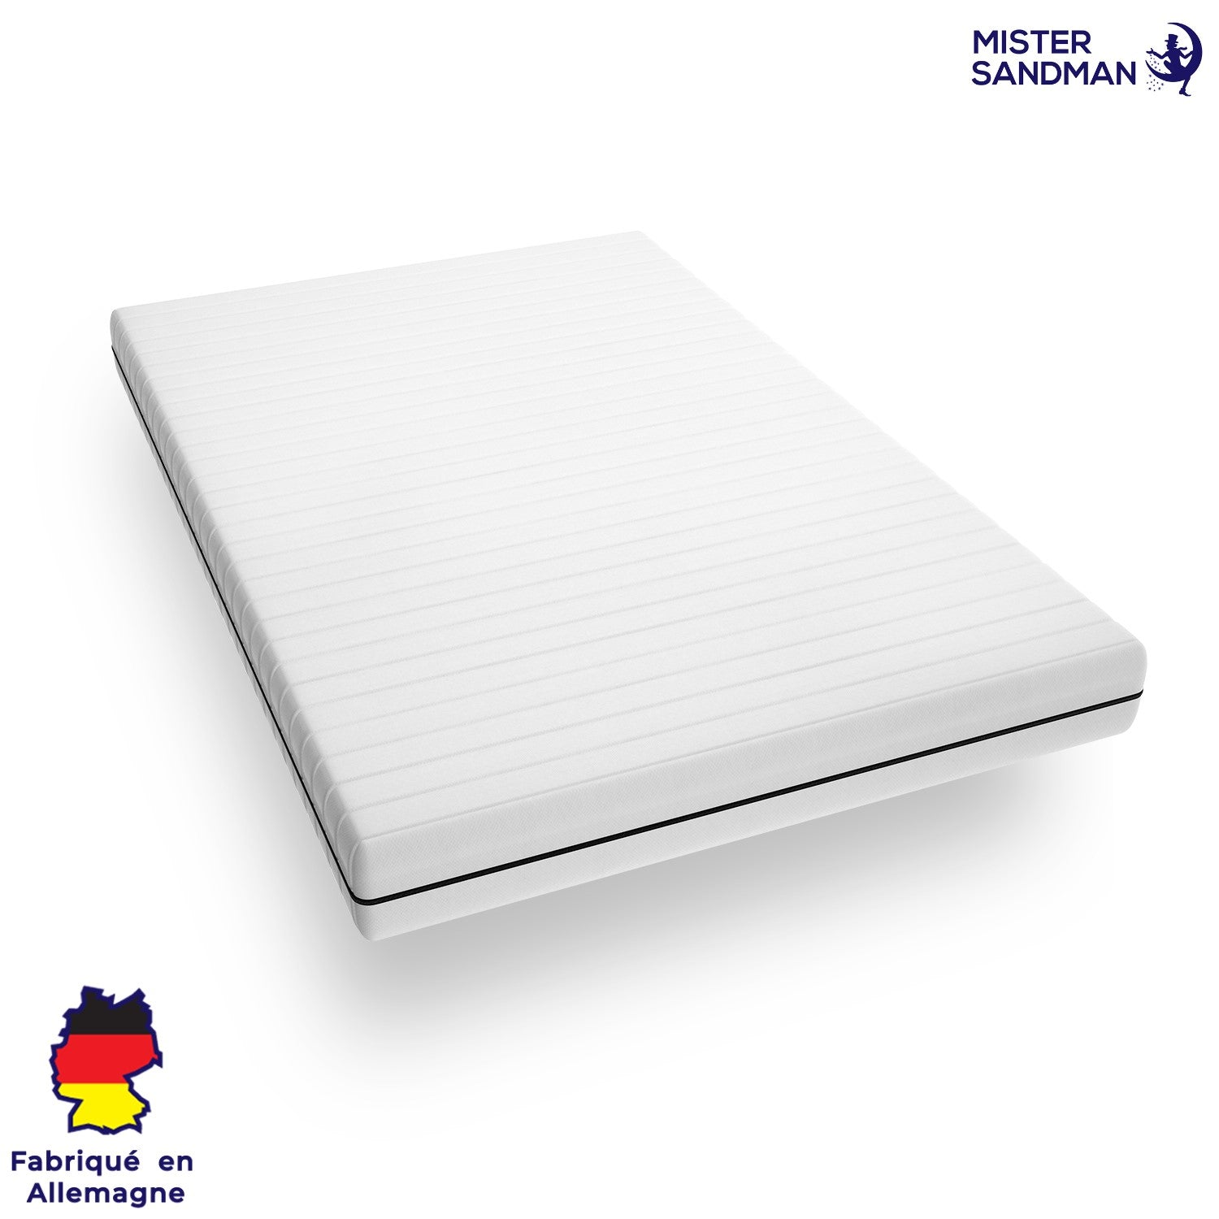
Set-up
Conforama (100 offers), Darty (50), Bol (35) and Cdiscount (
List of keywords (based on search volume)
Matresses offers / low sales (<5 per week) ; small products for bol!
Extraction on a daily basis for the top 100 results (2 pages)
Does the deletion of the icon make offers show up on google shopping?

Slide 10
Results
Upload timeline
Visibility
Upload statut | Conforama | Cdiscount | Darty | Bol
Week upload | KW10 | KW11 | KW13 | KW10
Offers upload | 103 | 68 | 51 | 35
Changes online (KW11) | 35 | 61 | / | 35
Changes online (KW12) | 51 | 65 | / | 35
Changes online (KW13) | 57 | 67 | / | 35
Changes online (KW14) | 92 | 68 | 38 | 35
Top100 GS (offers upload) | Conforama | Cdiscount | Darty | Bol
09.03 | 7 | 3 | 6 | /
KW11 | 17 | 8 | 10 | 17
KW12 | 15 | 15 | 10 | 15
KW13 | 17 | 9 | 14 | 16
KW14 | 21 | 6 | 16 | 15
Top10 GS (offers upload) | Conforama | Cdiscount | Darty | Bol
09.03 | 1 | 0 | 6 | /
KW11 | 3 | 1 | 4 | 5
KW12 | 0 | 0 | 4 | 2
KW13 | 1 | 1 | 6 | 3
KW14 | 1 | 0 | 6 | 2
Sales
Sales (offers upload) | Conforama | Cdiscount | Darty | Bol
KW10 | 159 | 24 | 14 | 21
KW11 | 179 | 36 | 12 | 4
KW12 | 136 | 26 | 16 | 14
KW13 | 222 | 35 | 33 | 11
KW14 | 202 | 35 | 24 | 18

Slide 11
Key results
Sales :
Darty (+10-15 in KW13-14) ; Conforama (+50-60 in KW13-14) ; Bol (-15 in KW11) ;
Visibility :
Top 100 : Darty (+5 in KW13-14) ; Conforama (+5 in KW14)
Top 10 : Darty (+2 in KW14)
More stability in the ranking than before!

Slide 12
Recommendations
Keep testing on succesful marketplaces Darty & Conforama
Make Darty a full google shopping marketplace
Stop testing on Cdiscount & Bol as it costs too much effort & time

Slide 13
Notes marketplace managers
Good recommendations
Change darty immidately
Next time ask Business analytics for help
Nice presentation & interesting topic for the future as well.

