Slide 1


Medisol – Dealer Cooperation Agreement
Festo Walusimbi - 70051
HZ University
International Business.

Slide 2
Overview
The problem
Missing information
The research process
Research outcomes
Conclusions
Recommendations
Professional Products

Slide 3


The problem
EU MDR 2017/745 requirement
Dealer loyalty

Slide 4
Missing Information
Factors that affect Buyer-Seller relationships
Requirements of the agreement according to EU MDR
Extent to which Medisol working ways encourage Buyer-Seller relationships
Need for existing agreements at Medisol to be revised
How the agreements can be used to keep dealers and meet MDR requirements.

Slide 5
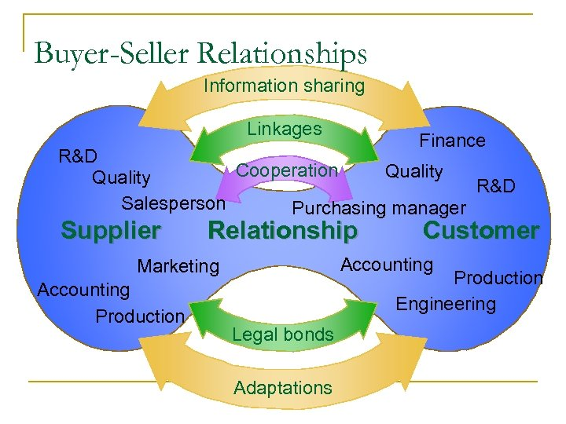

The research process

Slide 6

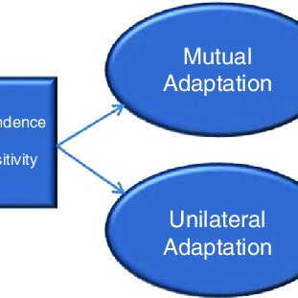


Research outcomes
Buyer-seller relationships
Information exchange
Buyer-seller Adaptations
Cooperation norms
Operational linkages.
Source: (Cannon & Perreault, 1999)

Slide 7
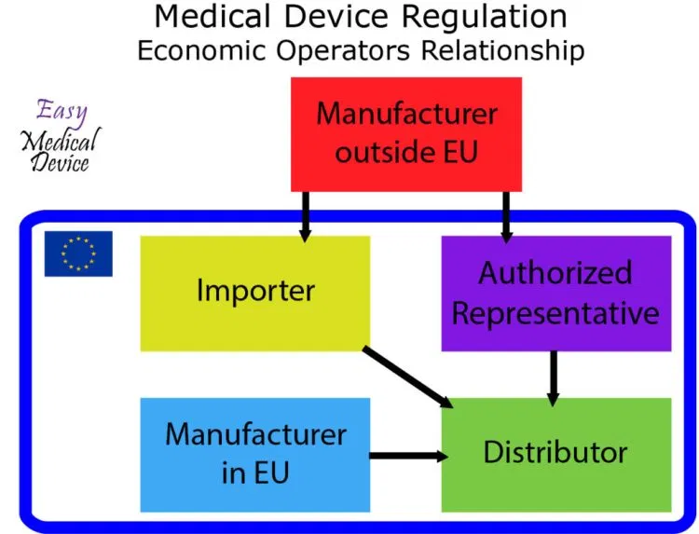
Research outcomes
MDR Economic Operators
Source: (Easy Medical Device, 2020)

Slide 8
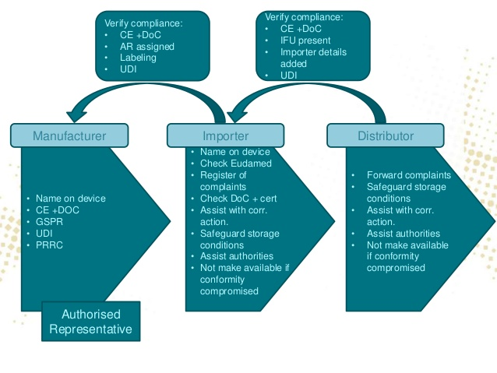
Research outcomes
Economic Operator Obligations
Source: (Szoboszlai & Vollebregt, 2019)

Slide 9
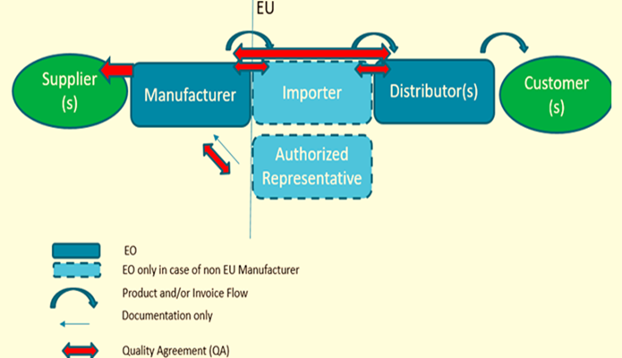
Research Outcomes
Quality Agreement
Source: (Szoboszlai & Vollebregt, 2019)

Slide 10
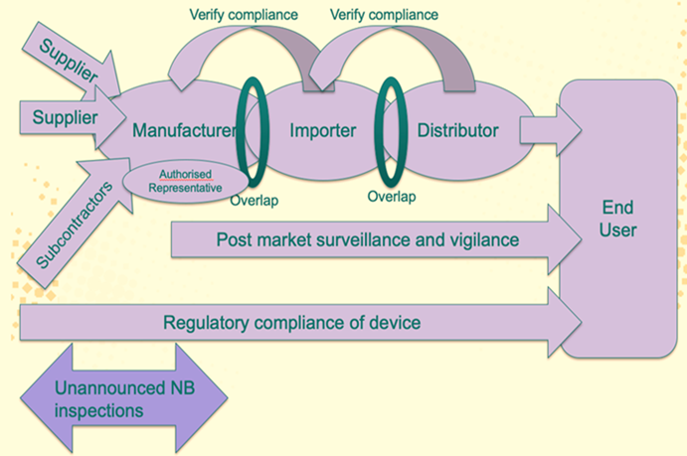
Research outcomes
Obligations overlap
Source: (Szoboszlai & Vollebregt, 2019)

Slide 11
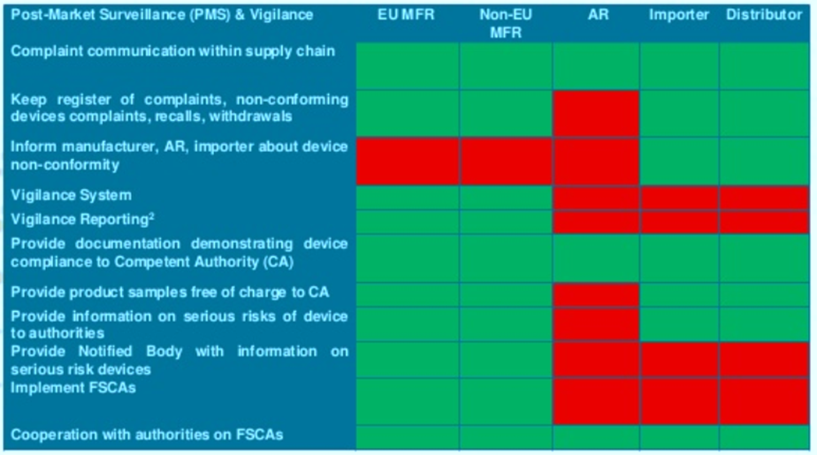
Research Outcomes
Obligations overlap PMS & vigilance
Source: (Medical Devices Legal, n.d.)

Slide 12
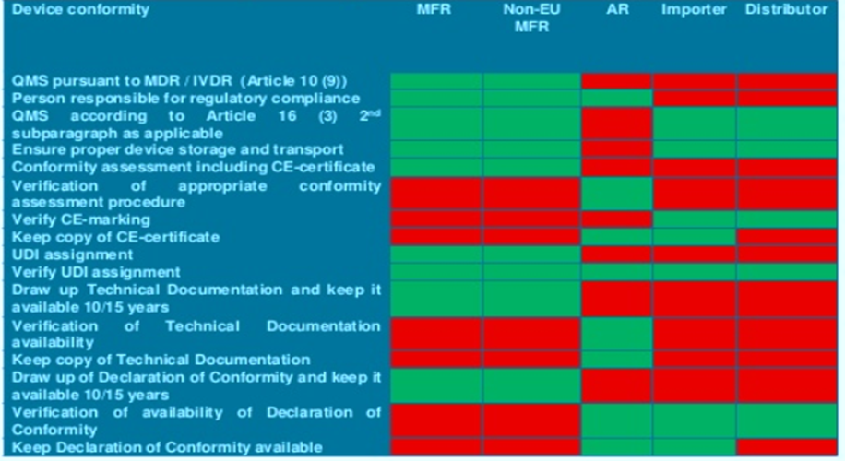
Research outcomes
Obligations overlap device conformity
Source: (Medical Devices Legal, n.d.)

Slide 13
Conclusions
Medisol ways of working facilitate buyer-seller relations
Introduction of uniform terms can be a challenge
Dealer satisfaction with current working ways not established
Not all salespersons saw the need for the new agreements
The current dealer agreement will be invalid when MDR takes full force
Medisol will be above dealers in the Economic operator supply chain

Slide 14
Recommendations
Develop four agreements
Review existing agreements and entry into new ones
The agreement should encourage operational linkages and information sharing
The commercial agreement terms and conditions should be adaptable
The agreement should be based on cooperation norms principles
Increase awareness of the importance of the agreements and the MDR in the company

Slide 15


Professional products
Commencement and periodic review
Purchase orders
Delivery
Payment
VAT
Harmonizing misunderstandings
Revision of agreement
Compliance with MDR
Signatures
Relationship of parties
Storage and transport requirements
Device traceability requirements
Handling returns and complaints
How obligations are to be fulfilled.

Slide 16

Questions

Slide 17
Sources

