Slide 1
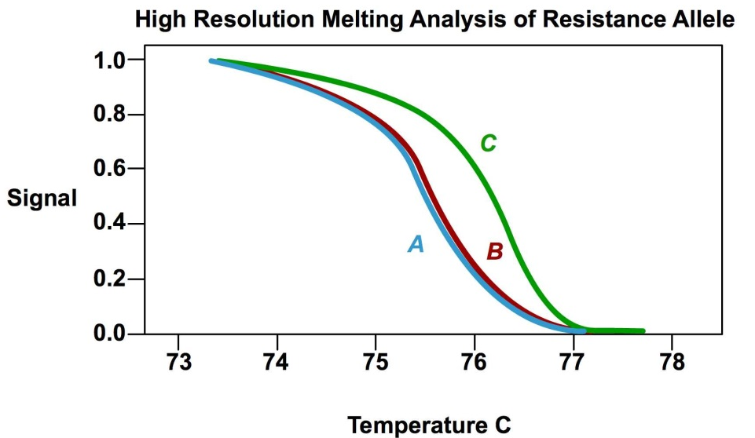
Developing Genetic Markers for Capsicum Disease Resistance Bas Rutjens & Nelleke Kreike Green Biotechnology, Hogeschool Inholland, Naaldwijkstraat 45, 1059GJ, Amsterdam
Introduction:
Genetic markers allow breeders to select for favourable traits with unprecedented speed and accuracy. In recent years great progress was booked in the development and implementation of marker-assisted selection (MAS) strategies throughout the plant breeding field. However, due to high R&D cost many small and mid-size companies still operate without MAS.
We set up a program to implement MAS in our curriculum by combining relevant questions from local breeders with up-to-date techniques. As a result students are early on exposed to new developments in the field of plant breeding and familiarized with questions in their future work field.
Here we describe a recently conducted study to develop genetic markers for disease resistance in a Capsicum breeding program in a multi disciplinary approach with the department of Horticulture & Agri-Business (Inholland, Delft)
Figure 2: High resolution melting analysis allows discrimination between C and A/B alleles in a single reaction (top). Results of the C-allele specific PCR (black band, which is absent in the A and B reactions) (left).
(A) (B) (C)
Plant DNA
Figure 1: Virus infections cause severe defects in Capsicum plants and fruits (Top). Cartoon of genetic variation (colored boxes represent differences in the genetic code) found in a Capsicum viral-resistance gene. Plants carrying the A allele have the least resistance whereas C offers the highest protection.
To confirm the accuracy of the test a bio-assay was conducted in collaboration with the department of Horticulture & Agri-Business (Inholland, Delft). To this end Capsicum plants from which samples were taken for the genetic test were inoculated with specific viral strains and checked for disease development. Bio-assays are laborious, depend on relatively old plants and often suffer from a-specific symptom formation that are caused by variations in growth condition and/or secondary infections.
A
Resistance
Level
B
C
Figure 3:
Results:
In collaboration with a local Capsicum breeder we designed a genetic test that detects the C resistance allele. Based on variations in the genetic code we were able to design 2 tests that allow simple and fast detection of the C allele (Figure 2).
Conclusion:
Our developed genetic test shows an accuracy of >99%. This test will allow the breeder to save money on growth and labour costs and greatly speed up breeding programmes.
In total 7 students have directly benefited from implementation of this research in our curriculum by actively contributing the the here described work. Moreover they have had direct contact with the breeder which has helped them to connect with their future work field.

