Slide 1
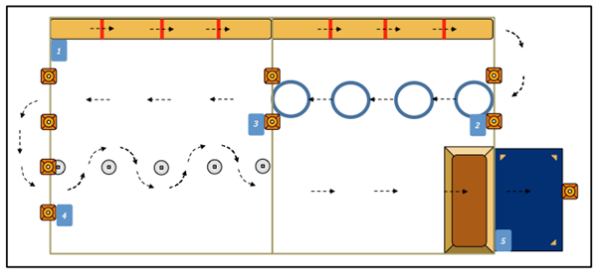
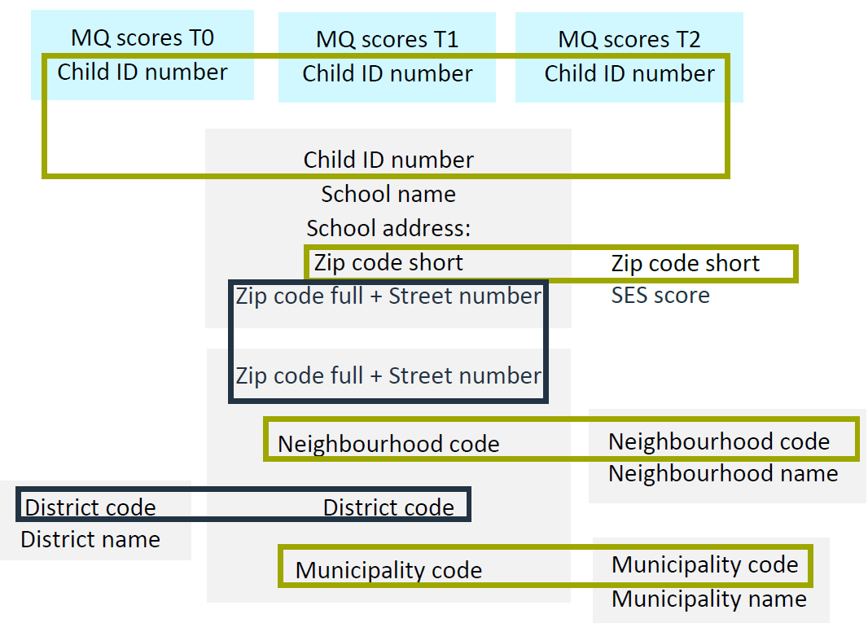
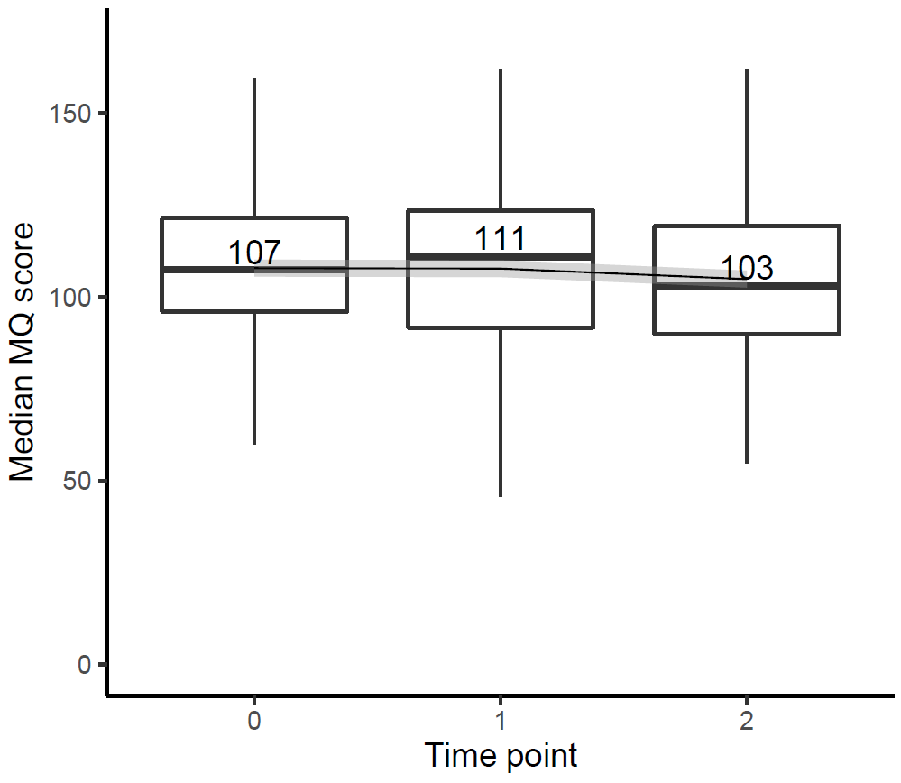
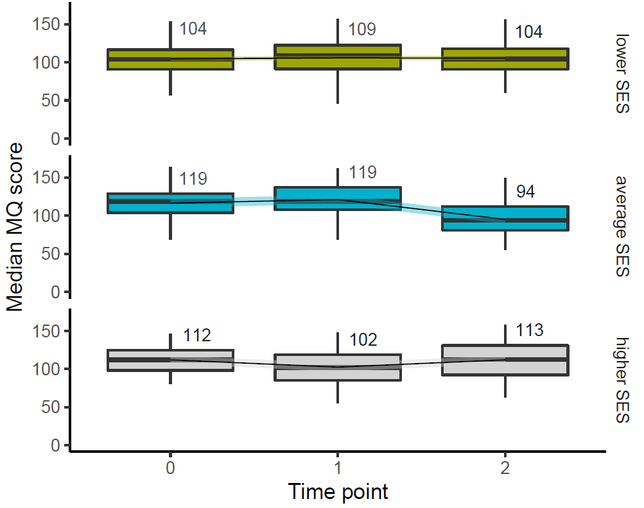
EXPLORING SOCIO-ECONOMIC INEQUALITIES IN CHILDREN’S MOTOR COMPETENCE
A pilot study merging data from different sources
Pim Koolwijk, Ester de Jonge, Joris Hoeboer, Sanne de Vries
The Hague University of Applied Sciences, Centre of Expertise Health Innovation
Recommendations
Public health relevance
Reduction of socioeconomic health inequalities is a major challenge in The Hague.
Suboptimal motor competence in early childhood can contribute to an unhealthy and inactive lifestyle later in life.
A worrisome overall decline in motor competence in primary school children is observed over the past decades.
Merging individual research data on motor competence to open source data on socioeconomic status (SES) provides an opportunity to explore health inequalities in early childhood.
Aim of this study
To examine the development of motor competence over time in primary school children.
To study differences in this development according to the SES of the child’s school district.
Merging data from different sources
Measuring motor skills
At baseline (T0), 530 children aged 4 to 7 years were enrolled in this study in the Hague.
The motor competence was measured at three consecutive years (T0,T1 & T2) in 341 children (64% of the baseline population).
Motor skills were measured using the Athletic Skills Track (AST): a reliable, valid, and feasible motor skill assessment tool for children in a physical education setting.
The track consists of a series of 5 concatenated fundamental movement skills (e.g., rolling, creeping and walking, Figure 2).
The time that children need to complete the track is converted into Motor Quotient (MQ) scores based on age- and gender-related reference values.
Enrich SES data of the school district with SES data of the child’s individual household.
Explore other potential determinants of differences in motor competence development.
Develop interventions targeting the most discriminating determinants of a decline in motor skills of young children.
Figure 2: AST-1 track.
The median motor competence of primary school children showed only minor fluctuations over time.
No clear differences in this development by SES of the school district were observed.
Preliminary results
All children with 3 repeated measures in The Hague
Development of motor competence over time
In subgroups of the SES of their school district
Ester de Jonge: E.A.L.dejonge@hhs.nl
Pim Koolwijk: P.Koolwijk@hhs.nl
Figure 1: Process of merging data from different sources.
Blue boxes: THUAS data.
Grey boxes: Open source data of Statistics Netherlands (CBS).
Figure 3: Development of median MQ scores over time in The Hague.
Figure 4: Development of median MQ scores over time
grouped by SES of the school district in The Hague.
Lower, n= 224 ; average, n= 58 ; higher, n= 59.
Centre of Expertise Health Innovation
https://www.dehaagsehogeschool.nl/onderzoek/kenniscentra/details/kenniscentrum-health-innovation

