Slide 1
The Myth of PDCA
Everard van Kemenade, PhD
EOQ congress 2014

Slide 2
PDCA
Cycle on organisational level

Slide 3
P
D
C
1 Leader-
ship
3. People
5
Processes
7 People
9 Key performance results
2 Policy and strategy
6 Customers
4 Resources and partners
8 Society
Enablers
Results
A

Slide 4
PLAN
Planned change, like when you use the PDCA-cycle, assumes that one type of approach is suitable for all organisations, all situations, all times in all cultures.
The chance that plans do not lead to what we want is 80% in the complex world
we live in.

Slide 5
DO
3. If we do what we planned, we might not do what is needed.
4. The plans made might make it difficult to stop activities put in motion.

Slide 6
CHECK
5. Many important quality issues cannot easily be checked/measured.

Slide 7
ACT
6. The most difficult step of the PDCA-cycle is act, because that often involves behavioral change of people. The PDCA-cycle does not take people into account.
7. The PDCA-cycle is a rational, hard instrument, where emotions, the soft side of quality is more crucial for change.

Slide 9
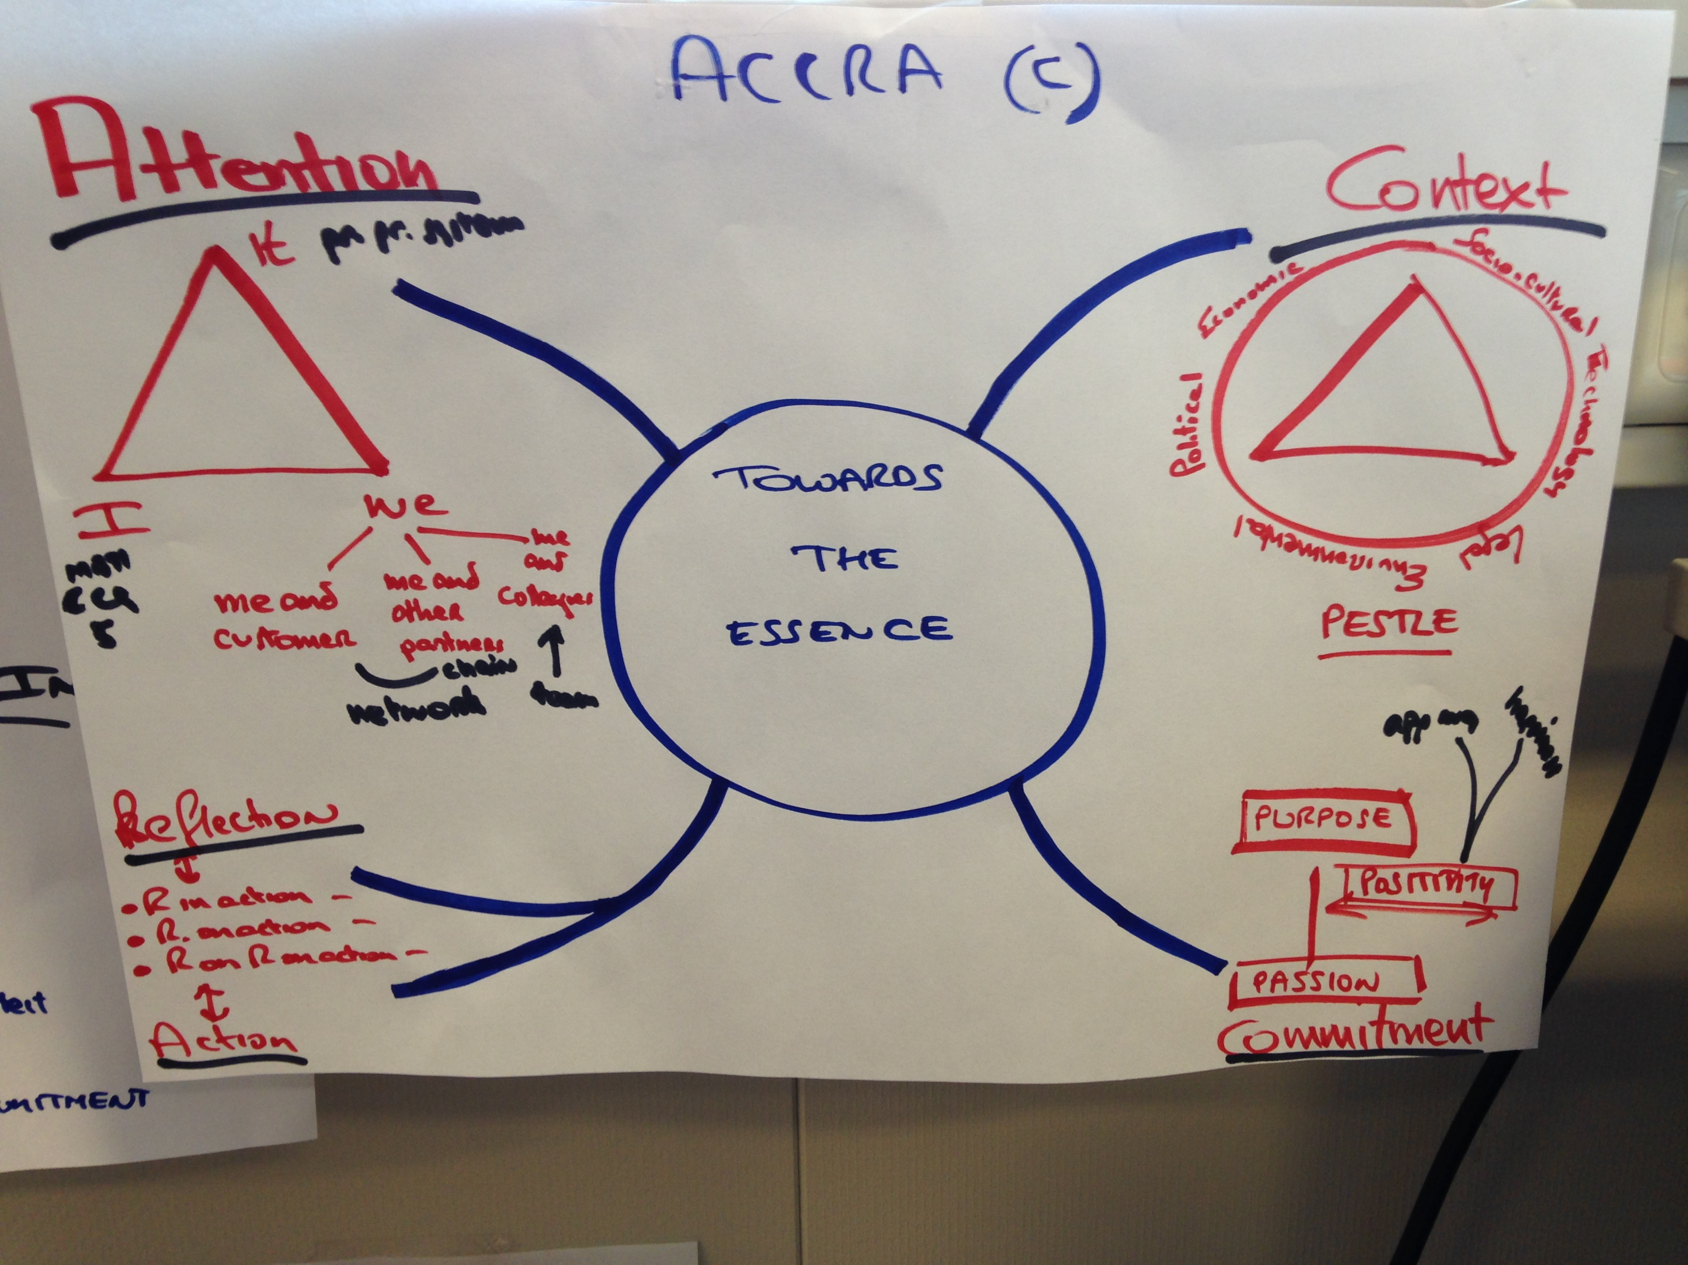
ACCRA ©
principles

Slide 10
Attention Context Commitment Reflection Actio

Slide 11
ATTENTION
Quality requires that you pay attention to:
IT ( PROCESS, SYSTEM)
ME
WE (CUSTOMER, PARTNER)

Slide 12
Open up the hearts for change

Slide 13
CONTEXT
2. Quality requires to take the context into consideration
CONTEXT
IT
ME
WE

Slide 14
It is the context (political, economic, socio-cultural, technological, legal end environmental) that gives meaning.

Slide 15
COMMITMENT
3. Quality requires to strive for
based on
PURPOSE
PASSION AND POSITIVITY

Slide 16
The power of positivity
video

Slide 17
REFLECTION
4. Quality requires reflection:
REFLECTION-IN-ACTION
REFLECTION-ON-ACTION
REFLECTION ON REFLECTION-ON-ACTION

Slide 18
ACTION
Start the engine and move.

Slide 19
DISCUSSION
The PDCA cycle at organisational level does not work in a complex, fast changing environment.

