Slide 1


HZ UAS
Start
GRADUATION PRESENTATION
“Innovative educational strategies for the digital age”
HZ Innovation Studio: The Garage
SWASTIKA REGMI / 81485
6/29/2023

Slide 2
CONTENTS
Organization overview
Problem
The research
Main recommendations
Professional product
Overall feedback and recommendation
SAFe
Overall implementation plan
| Graduation Presentation| Swastika Regmi |

Slide 3




Organization overview
An innovative studio
Located in HZ-tower, Vlissingen
Working space for students
Collaborates with HZ partner universities
| Graduation Presentation| Swastika Regmi |

Slide 4

Problem
To bring in more international students
Had a plan for implementing COIL but no action were taken
| Graduation Presentation| Swastika Regmi |

Slide 5

The research
How can The Garage encourage incoming students to participate in interdisciplinary projects through COIL?
| Graduation Presentation| Swastika Regmi |

Slide 6
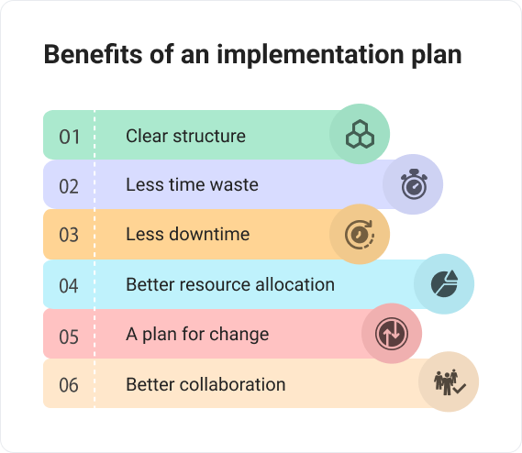
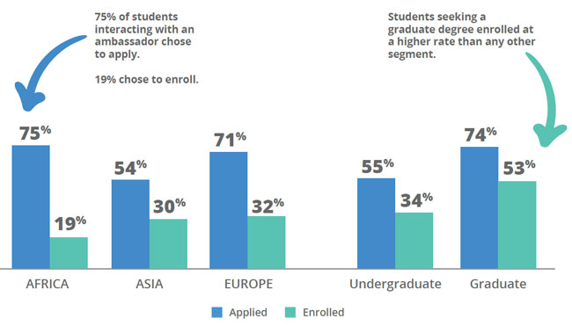
Main recommendations
¹ Source- https://bordio.com/blog/implementation-plan/
²Source- https://monitor.icef.com/2020/02/peer-to-peer-effect-in-international-student-recruitment/
COIL implementation process
Student ambassador
Collaborate with the International office
Mentorship trainings and workshop for COIL
| Graduation Presentation| Swastika Regmi |

Slide 7
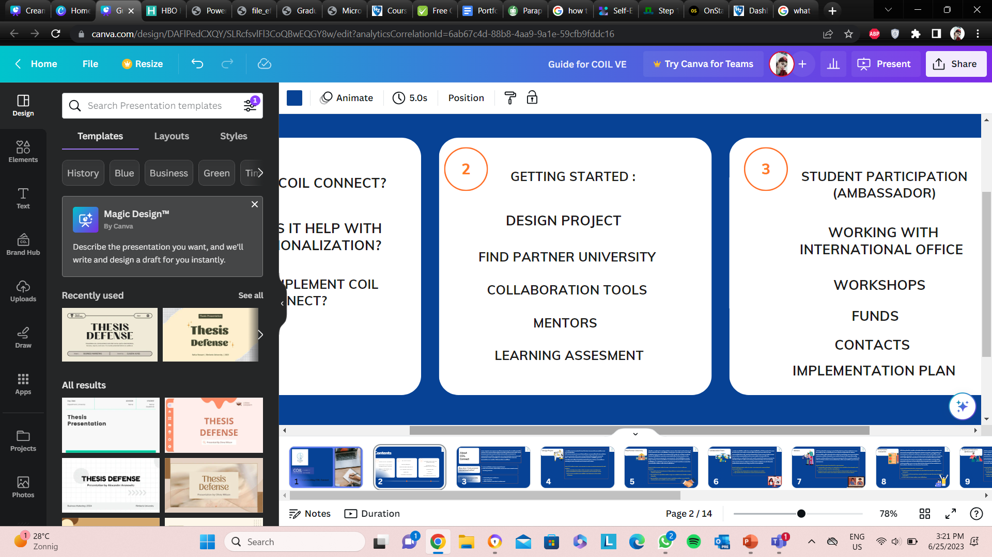
Professional product
COIL Implementation Guide
| Graduation Presentation| Swastika Regmi |

Slide 8
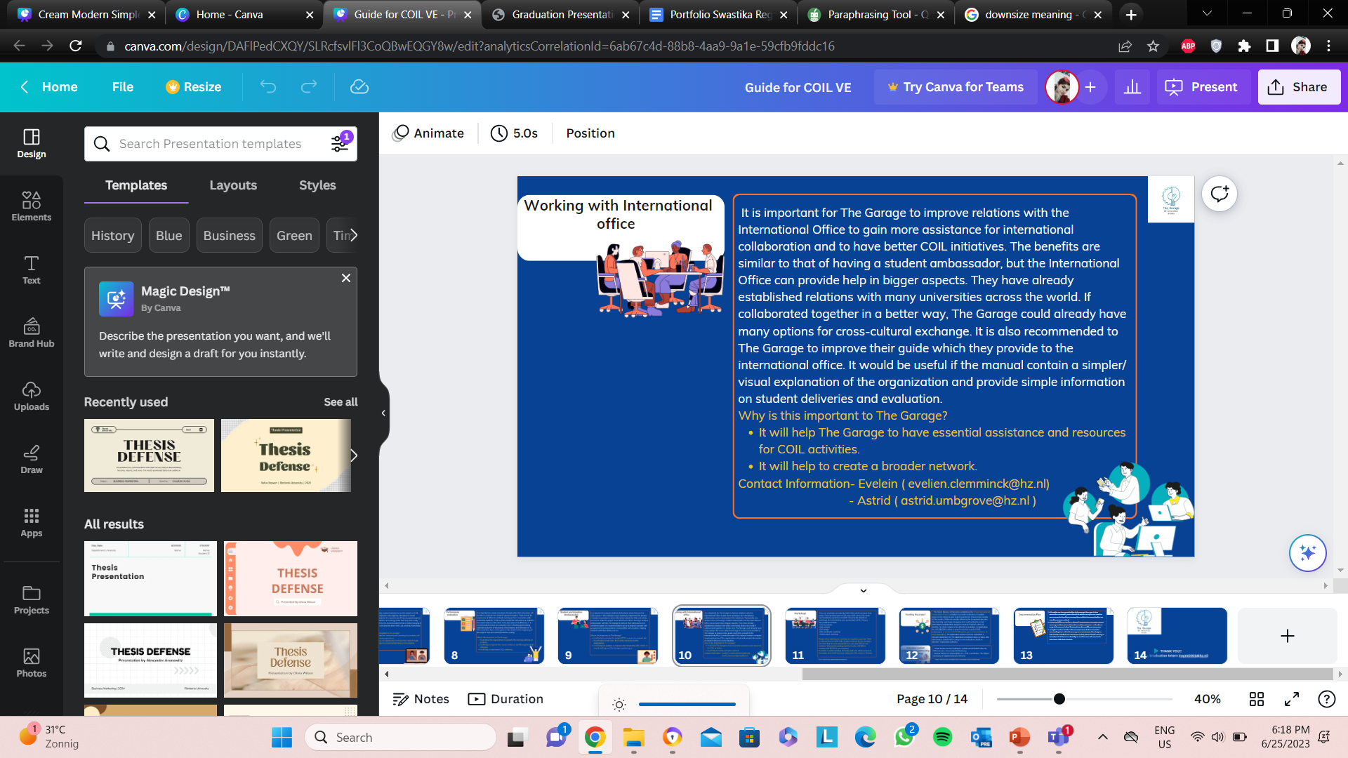
Professional product
Collaborate with the International Office
| Graduation Presentation| Swastika Regmi |

Slide 9
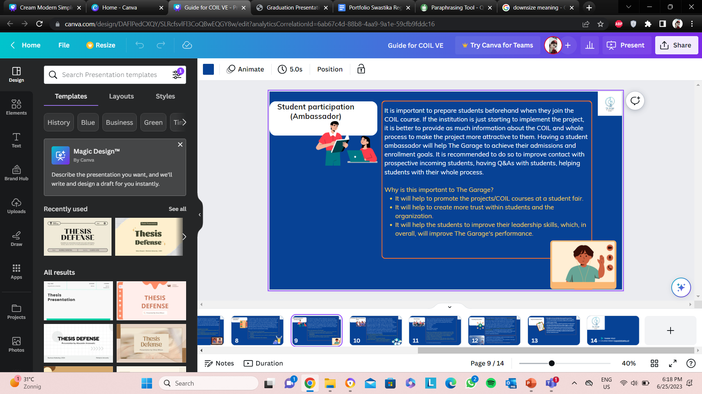
Professional product
Student ambassador
| Graduation Presentation| Swastika Regmi |

Slide 10
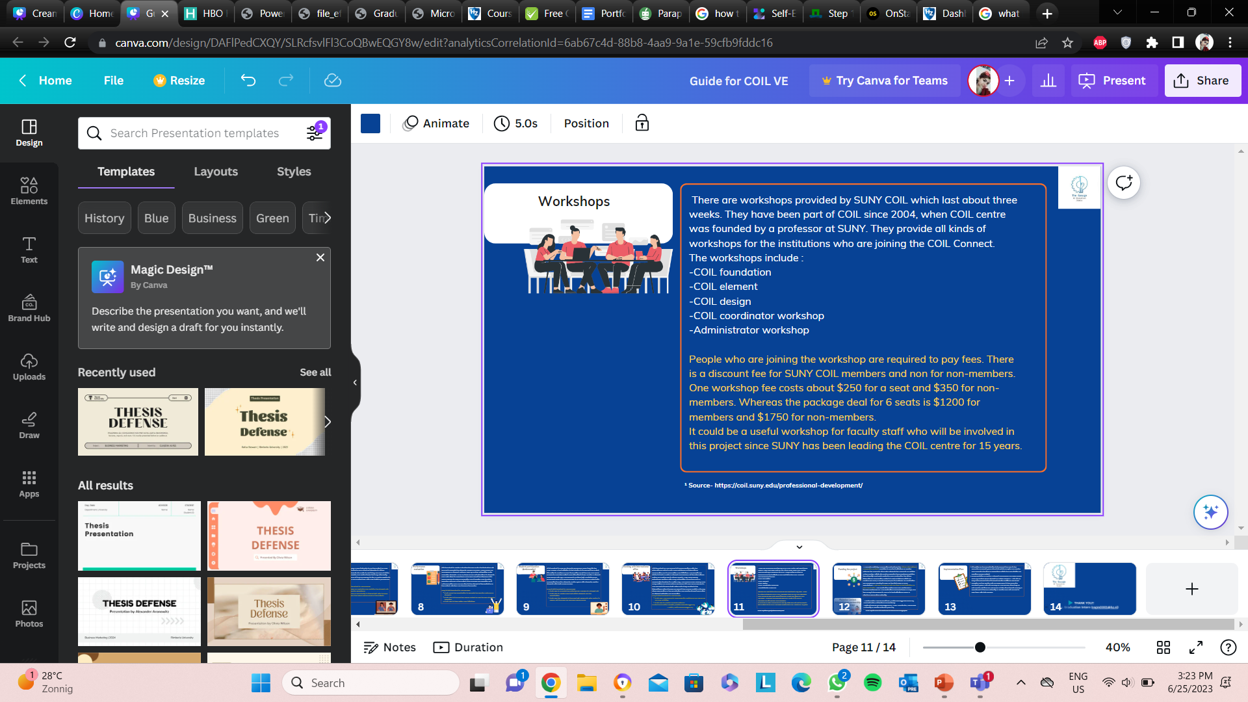
Professional product
Mentorship trainings and workshop for COIL
| Graduation Presentation| Swastika Regmi |

Slide 11

Overall feedback and recommendation
| Graduation Presentation| Swastika Regmi |

Slide 12

SAFe
Suitable
  Clear guide with practicable instructions.
  through the provided guide, The Garage will start collaborating better with International Office.
Acceptable
  The Garage is aware of the time they need to implement the recommendation. Most likely they will start from upcoming semesters.
| Graduation Presentation| Swastika Regmi |

Slide 13
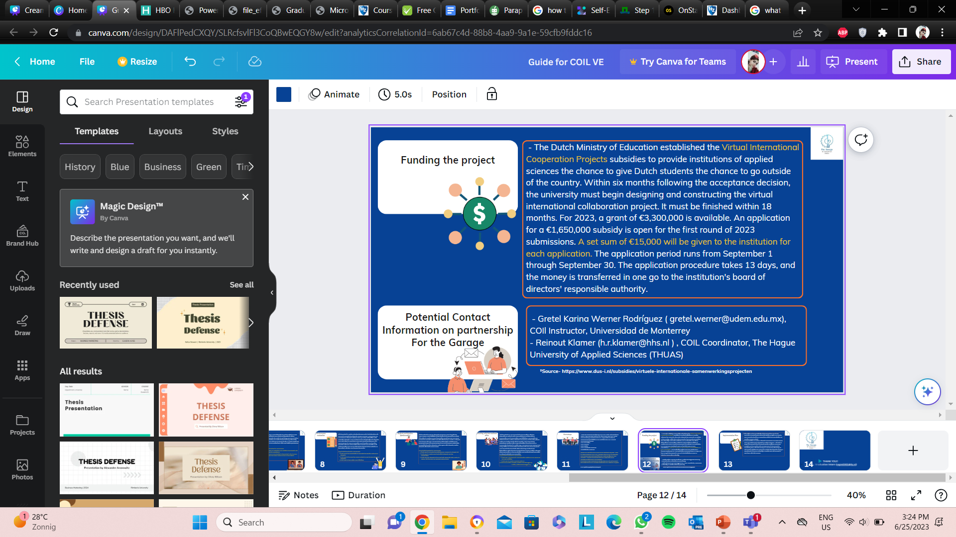
SAFe
Feasibility
  The Garage will have enough capital for implementation of this project.
| Graduation Presentation| Swastika Regmi |

Slide 14
Overall implementation plan
The Garage will be able carry out the COIL implementation process in up-coming academic years.
Implementation of Student ambassador has already been taken by one of The Garage's Intern who will look further in having ambassador through HZ Student Success Center.
Application process of subsidy will be taken care by one of the department at HZ who take cares of applying for funding for the HZ.
| Graduation Presentation| Swastika Regmi |

Slide 15

Thank you for listening
Swastika Regmi
Student number- 81485
HZ University of Applied Sciences
29 June 2023
| Graduation Presentation| Swastika Regmi |

